Slide 1


B.Tech Computer Science and Engineering – Vth Semester
Theory of Computation
Department of Computer Science and Engineering

Slide 2
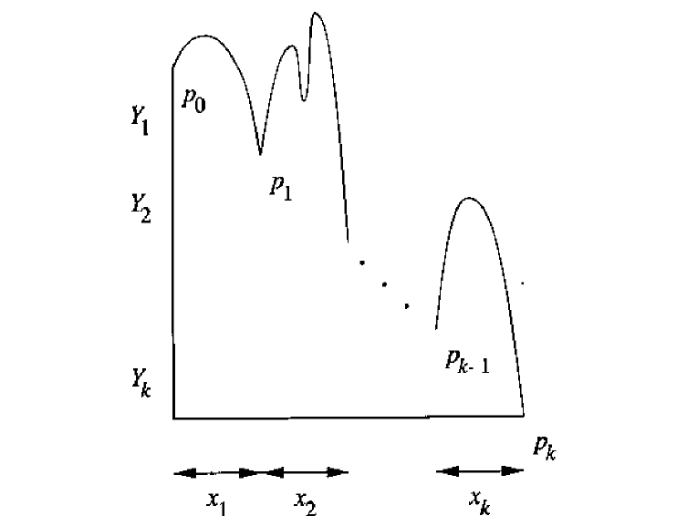
EVERY PDA HAS AN EQUIVALENT CFG
Every PDA pops stack symbols while it consumes symbols in the input.
The figure shows how stack changes by consuming inputs and finally empties its stack (remember we have considered PDA which accepts with empty stack).
Here the stack symbol Y1 is popped by consuming x1 after undergoing several changes.

Slide 3
The stack poping and consumption of inputs
Suppose the PDA starts with in a state q₀ and Y₁ at the top of the stack. After several moves Y₁ will be popped as net effect by then the PDA might be in a state p₁.
The PDA then proceeds to pop out the stack symbol Y₂. After several moves the PDA will be in a state q₂ and pops out Y₂.

Slide 4
Construction of Grammar G
Our construction for an equivalent grammar uses variables.
These variables represents a event consisting of
The net popping of some symbol X from the stack.
A change in state from some state p at the beginning to q when X has finally been replaced by ε on the stack.
We represent such a variable by composite symbol [pXq]

Slide 5
Theorem 6.14 : Let P={Q,∑,Γ,δ,q₀,Z₀} be a PDA then there is a Context Free Grammar G such that L(G)=N(P).
Proof: We shall construct G={V,∑,R,S}
The set of Variables V consists of
1. The special symbol S, which is start symbol and
2. All symbols of the form [pXq], where p and q are states in Q
and X is stack symbol in Γ.
The productions of G are as follows
For all states p , G has the production S->[q₀Z₀p].
Remember [q₀Z₀p] represents an event which makes the PDA to pop Z₀ from
stack by moving from state q₀ to p. (i.e) (q₀,w, Z₀) Ⱶ (p,ε,ε).
This means the starting symbol generates all strings w that causes empty
stack.

Slide 6
Contd...
2. Let δ(q,a,X) contains the pair (r,Y₁,Y₂,…Y_{k})
Here a is either a symbol in ∑ or a= ε.
K can either be any number, including 0 in which case the pair is (r, ε).
then for all list of states r₁,r₂,…r_{k} G has the production
[q X r_{k}] ->a[rY₁r₁] [r₁Y₂r₂] [r₂Y₃r₃]…. …. [r_{k-1}Y_{k}r_{k}]
This production says one way to pop X from stack and go from state q to state r_{k} is to read ‘a’. then use some input to pop Y₁ and move from state r to r₁ and so on.
We shall now prove the informal interpretation of the variable [qXp] is
correct: [qXp] ->* w if and only if (q,w,X) Ⱶ* (p,ε,ε)

Slide 7
proof
(If) suppose (q,w,X) Ⱶ* (p,ε,ε) we shall show (qXp) ->*w by induction on the number
of moves made by PDA.
Basis : One step, Then must be in δ(q,w,X)= (p,ε)
Then we can write the production [qXp]->w (by applying the rule2)
Suppose the sequence (q,w,X) Ⱶ* (p,ε,ε) takes n steps and n>1 then the first
move must look like
(q,w,X) Ⱶ(r₀,x,Y₁Y₂… Y_{k}) Ⱶ*(p,ε,ε) Where w=ax , where a is in ∑ or ε
It follows that δ(q,a,X)= (r₀,Y₁Y₂… Y_{k})
Then by construction of G there is a production
[qXr_{k}]->a[r₀Y₁r₁] [r₁Y₂r₂]….. [r_{k-1}Y_{k}r_{k}] where r_{k}=p and r₁ r_{2…} r_{k} are states in the PDA
(r_{i-1},w_{i}, Y_{i})Ⱶ*(r_{i­},ε,ε)

Slide 8
Proof
(only if) The proof is on the number of steps in the derivation.
Basis: One step the [qXp]->w must be a production
There is only one way for this production to exist, there is a transition in PDA which pops X and moves from state q to p.
(q,w,X)= (p,ε,ε) (just apply the PDA to CFG conversion rule in reverse).

Slide 9
Proof
Induction:
Suppose [q,X,p]->*w by n steps n>1.
We consider the first sentential form
[qXr_{k}] -> a[r₀Y₁r₁] [r₁Y₂r₂] [r₂Y₃r₃]…. [r_{k-1}Y_{r}r_{k}] ->* w
Here r_{k} = p. This production must come from
δ(q,a,X)=(r₀, Y₁Y₂…Y_{k})
we can break w as w=aw₁w₂w₃…w_{k} such that [r_{i-1}Y_{i}r_{i}]->*w for all i=1..k

Slide 10
proof
by inductive hypothesis we all know that i
(r_{i-1},w_{i},Y_{i})Ⱶ*(r_{i},ε,ε)
By extending we also know that
(r_{i-1},w_{i}w_{i+1}….w_{k}, Y_{i} Y_{i+1…} Y_{k})Ⱶ*(r_{i-1},w_{i+1} w_{i+2}….w_{k}, Y_{i+1}Y_{i+2…} Y_{k})
By putting all equations together
(q, aw₁w₂w₃…w_{k ,}X)Ⱶ(r₀, w₁w₂w₃…w_{k ,} Y₁ Y_{2…} Y_{k})Ⱶ*(r₁, w₂w₃…w_{k ,} Y₂ Y_{3…} Y_{k})…..Ⱶ*(r_{k},ε,ε)

Slide 11
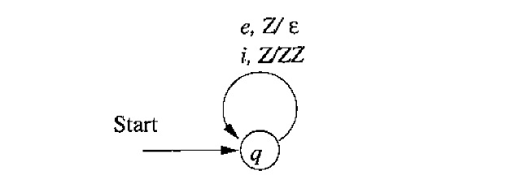
Converting the PDA into CFG

Slide 12
Converting the PDA into CFG
S->[q₀Z₀p] for all states p in the PDA
δ(q,a,X) = (r,Y₁,Y₂,…Y_{k})
[q X r_{k}] ->a[rY₁r₁] [r₁Y₂r₂] [r₂Y₃r₃]…. …. [r_{k-1}Y_{k}r_{k}] where r_{i} represents the states in the PDA.
First we will convert the PDA into transition functions
δ(q,I,Z)=(q,ZZ)
δ(q,e,Z)=(q,ε)
Productions in the equivalent CFG
S->[qZq]
δ(q,i,Z)=(q,ZZ)
[qZq]->i[qZq][qZq]
δ(q,e,Z)=(q,ε)
[qZq]->e

Slide 13
Converting the PDA into CFG
S->[qZq]
[qZq]->i[qZq][qZq]
[qZq]->e
Remember this triplet can be replaced with a simpler notation . Here we replace [qZq] with A
S->A
A->iAA
A->e
You can see S is a unwanted indirection tech =nically speaking both A and S represents the same language.
A->iAA
A->e
ie
A->iAA
A->ieA

